Slide 1
Group 4
Zac Cooper
Doug Simpson
Heather Bishop

Slide 2
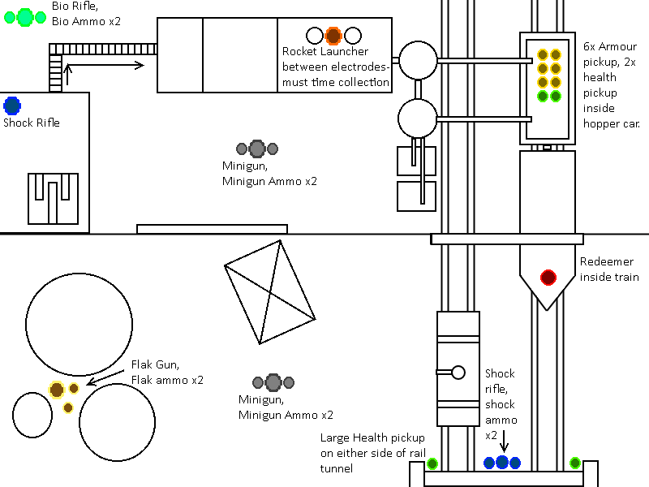
Design One
Floor Plan

Slide 3

Design One
Visual Feel

Slide 4
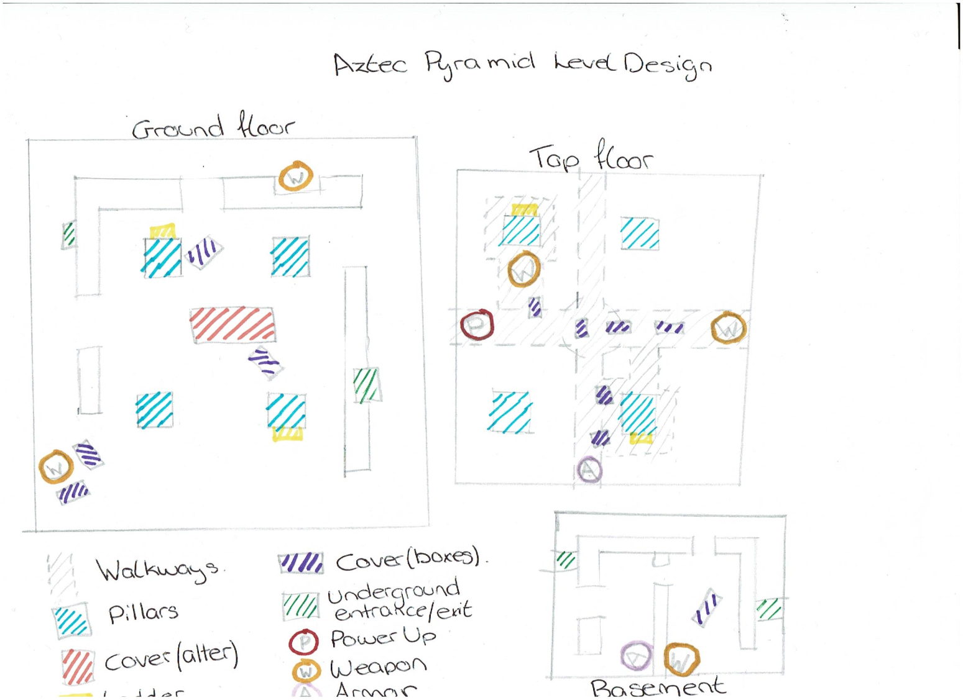
Design Two
Floor Plan

Slide 5

Design Two
Mood Board

Slide 6
Design Three
Floor Plan
Visual Feel
Arcitecture
Assets

Slide 7
References

Slide 8
Questions?

